Slide 1
The importance of counting sheep effectively
Cheryl Lythgoe – Society Matron
Nurse consultant within general practice by background, managing patients clinical concerns from cradle to grave.
Experience in commissioning and managing service delivery.
Social scientist – undertaking PhD

Slide 2
The objectives
Understanding the physiology around sleep
Identifying common sleep issues
Managing common sleep issues

Slide 3
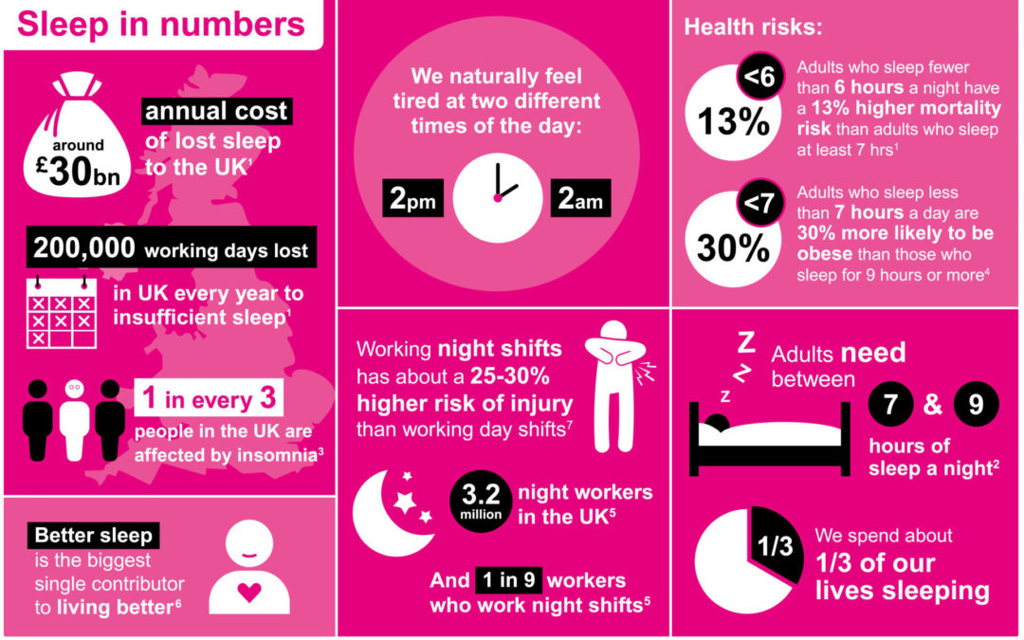
Notes:
Sleep helps our bodies thrive through supporting a healthy immune system, balances our appetite (through regulation of the hormones ghrelin and leptin), allows physical and mental restoration, supports information processing and memory function and decreases internal inflammation and stress. Therefore, for those times when we are sleep deprived we can understand why we feel sluggish, unable to make decisions and are more prone to illness. A continued lack of sleep, or oversleep for that matter, has been linked to a higher incidence of cancers.

Slide 4
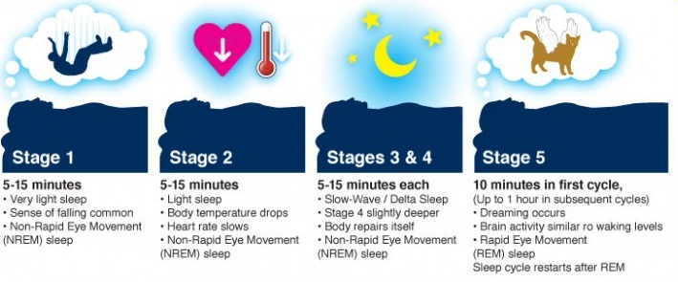
Sleep Architecture
Notes:
An average sleep pattern alternates between two cycles, REM (Rapid Eye Movement) and NREM (Non-Rapid Eye Movement). These cycles repeat themselves approximately every 90 minutes and consists of various stages.
Physiologically the following processes happen
Stage one sleep
Temperature decreases, your muscles relax and you can easily be woken
Stage two sleep
Heart rate and breathing slows down, your brain disconnects from its environment and outside stimuluses and begins to make memories
Stages three and four
Body is less responsive to external stimulus with the breathing and rate being at it’s lowest and stable. Decreased blood flow to the brain with a decrease in brain temperature
At this stage the body repairs and renews itself.
The pituitary gland releases a pulse of growth hormone to stimulate muscle growth and repair, with the immune system beginning its work in shoring up its resources for the next day.
Between stages four and five
We transitions into REM sleep where during the time the eyes move rapidly behind closed eyelids and represent the only active muscle movement we have in the body other than its essential functions.
The arms and legs are essentially incapacitated other than involuntary spasms with a progressive decrease in spinal reflexes – this is known as desynchronised corticol activity.
The brain is super active – dreaming is occurring which causes the heart rate, blood pressure and breathing to slightly increase.
Stage five
The brain is more active and memory storage is at its most efficient
We go through these stages on a cyclical process and providing we are experiencing a good level of sleep the times in stages four and five extend throughout the night
This is a typical sleep pattern. Most people go through the cycle five times in eight hours, As the night progresses non REM sleep becomes shorter and REM sleep becomes longer. Brain waves are shown in the circles.
Therefore in those last few hours of sleep we get the benefit of prolonged REM sleep which is the most beneficial for the body.
We don’t have one stimulation site in the brain that can promote REM sleep but some lesions to specific brainstem areas eliminate REM sleep.
REM sleep is induced through a number of chemicals including dopamine, acetylcholine and noradrenaline – although it’s not quite clear as to whether these modulate the circadian rhythm rather than sleep.

Slide 5
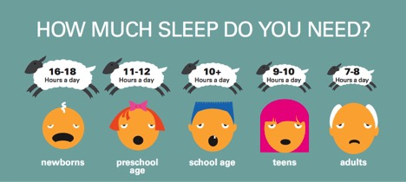
Notes:
Internal structures produce chemicals that support sleeping and waking. The control of sleeping and waking, you’re internal clock, is known as your circadian rhythm.
Circadian rhythms are strongest between midnight and 6am and is self regulating but external cues I.e., exposure to light can affect it. Consider the stats shown earlier that night shift workers are 25-30% at higher risk of injury than their daytime counterparts.
Within the brain we have melatonin receptors that aid in our sleep patterns. Melatonin is a hormone that is produced in a predictable daily rhythm in the brain from the pineal gland. Hormone production can rise at sunset and decrease at sunrise.
For some people they can manage on 5-6 hours sleep a night and feel perfectly refreshed and energetic – these individuals may have a genetic change that allows healthy body functions on less restorative sleep.
It’s reported that only a 1/3 of adults get the recommended amount of sleep

Slide 6
Sleep Problems
Insomnia is the inability to sleep.
Hypersomnia (narcolepsy) excessive drowsiness and falling asleep
Sleep-wake schedule disturbance transient or persistent
Partial arousal sleep walking, nightmares
Nightmares and night terrors disruption of REM sleep
Sleep apnea – interrupted breathing
Notes:
Insomnia The most common type of insomnia is difficulty in falling asleep.
Many psychologists believe that the best ways to overcome insomnia do not involve medication.
They recommend using relaxation techniques, establishing regular bedtimes, and using pleasant images to relax.
Hypersomnia - commonly known as narcolepsy is a rare sleep problem where people suddenly fall asleep no matter what time it is or where they are – its believed to be a genetic disorder of REM sleep functioning.
Sleep wake schedule disturbance – sleeping without any real routine or schedule. Rare condition and usually occurs in people with a brain function disorder.
Partial arousal – more common in children where they are partially awakened from their deep sleep, therefore they go through an abnormal sleep pattern which results in the body being in a confusional state -
Nightmares and night terrors are a product of REM sleep. People who are anxious or depressed are more likely to have nightmares.
Night terrors are like nightmares, but they are more severe. Night terrors tend to occur during deep sleep. Common in children
Sleep apnea – multiple extended pauses in breath when they are sleeping. Commonly associated with being overweight, some respiratory problems, smoking and can have a correlative factor to neck size. Chronic snoring is the most common symptom of obstructive sleep apnea. Consider this knowing that poor sleep increases the risk of obesity which in turn increases sleep problems
All of these are often associated with anxiety, psychological disturbance or prescribed/unprescribed substance use – consider prescribed medication, alcohol, drug taking
Little known about causes
Limited capacity for pharmacological treatment of sleep disorders

Slide 7
Why does sleep deprivation matter?
Shortened life span
Increases risk of heart disease, stomach problems, memory problems, obesity, diabetes, hypertension
Negative mood (irritability and depression)
Decreased work performance and memory lapses
Marital, social and employment problems
Difficulty concentrating/learning – consider driving
Increased addictions (alcohol, drugs, gambling, shopping)
Notes:
Lack of sleep affects both the mind and the body. Sleep deprivation can produce mental states of fatigue, drowsiness and irritability. In addition the lack of sleep gives physical symptoms and long term health risks which studies have shown increased the risk and rates of obesity, diabetes, heart disease, high blood pressure, stroke and Alzheimer’s..
Consider our earlier statistics that 13% who get less than 6 hours will have increased mortality and 30% who have less than 7 hours will have obesity.
In turn individuals are more likely to live of stimulants and sugar therefore junk food and caffeine tend to be their mainstay – this in term increases their risk of obesity which again drives sleep problems.
Signs that someone may be struggling with sleep deprivation are cognitive social and behavioural performance becomes impaired or altered, poor work performance and decreased output, poor time keeping, difficulty with presenteeism or increased absenteeism.
Consider the type of role undertaken – if their driving, making risk critical decisions, working with heavy machinery,– all of these may be at greater risk of the person is suffering sleep deprivation

Slide 8
Medication
Prescribed Hypnotics –(morphine, benzodiazepines, barbiturates)
Melatonin
Serotonin precursors – tryptophan
Over the counter Sedating anti-histamines
Over the counter hypnotics (Sleepeze etc)
Notes:
Medication was once commonly prescribed to aid sleep but in modern day medicine many of these have little to no benefit.
The quality and quantity of sleep that is derived from these drugs doesn’t provide or restore a natural sleep pattern.
Prescribed hypnotics – diazepam, temazepam etc don’t induce a natural sleep pattern and you get a decreased level of REM sleep and a poorer quality of your waking hours. Therefore the body isn’t going through that required physiological growth and repair, memories aren’t being ‘laid down’ and you often feel ‘hungover’ the next day. They are also highly addictive therefore the risk of using is greater than the benefit.
Melatonin and Serotonin precursors do induce natural sleep patterns but are only available under specialist advice therefore many GP;s wont prescribed these unless seen by a specialist first.
The use of sedating anti histamines aren’t sold directly for their hypnotic properties but rather some use their side affect to restore sleep patterns. Not recommended

Slide 9
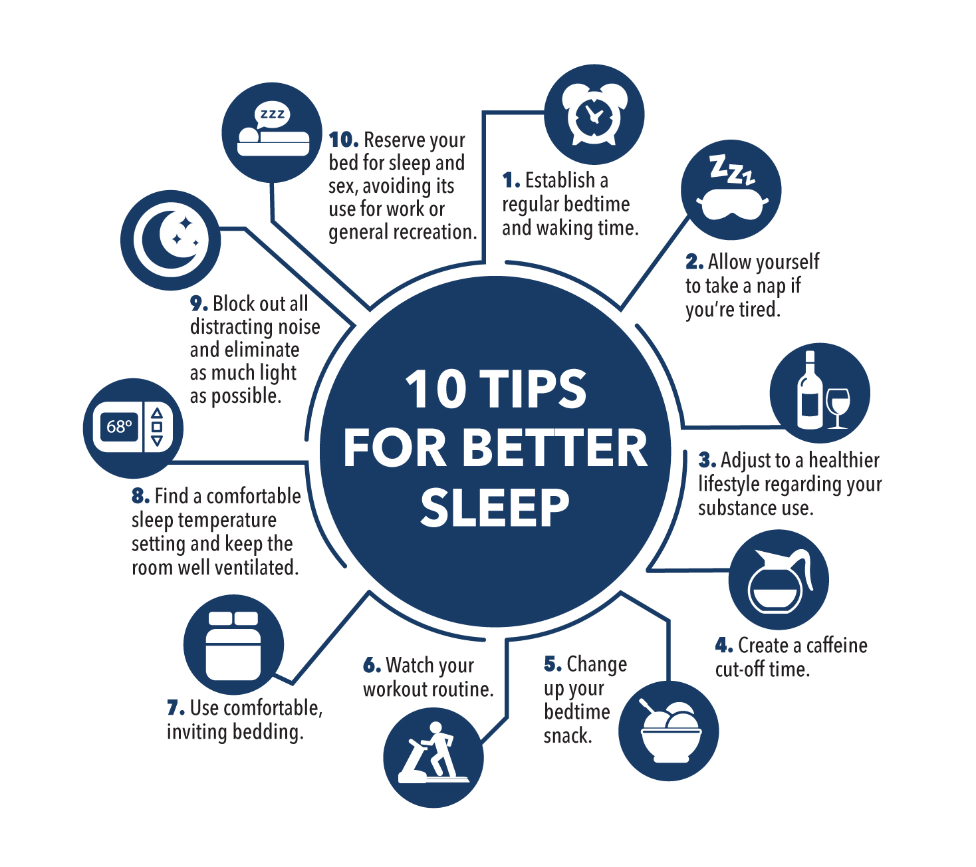
Notes:
Poor sleep may be secondary to many factors – medication, stress, alcohol, habit
So what actually is sleep hygiene
It’s defined as habits and practices that are conducive to sleeping well on a regular basis.
Developed in the 1970’s and it explores and recommends how your behaviours and environment can improve your sleep practices to maintain your physical and mental wellbeing. It’s a set of guidelines that don’t require medical intervention and can be undertaken under the guise of self care. As with any self care routine it has to be practiced, doesn't always work first time and often needs habit formation to see great benefits.
The formation of healthy habit forming is an essential part of protecting our minds and bodies – it’s a little bit like investing in your own bodies life insurance policy. The more you commit the greater chance of rewards, These practices can help you get to sleep easier and feel more rested
The basic premise of sleep hygiene is the same for everyone - but what ideal sleep hygiene looks like can vary between individuals.
1. Stick to a sleep schedule – even on weekends
2. Don’t take naps after 3pm – keep power naps less than 1 hour
3. Avoid alcoholic drinks before bed
4. Avoid caffeine and nicotine
5. Avoid large meals and beverages late at night before going to bed
6. Exercise is great but not too late in the day
7. Relax before bed, ? taking a hot bath.
8. Have a good sleeping environment – get rid of anything in your bedroom that might distract you from sleep and ddopt good sleep postures
9. Have the right sunlight exposure – During the day aim to get some exposure to natural light, sunlight is one of the key drivers for our circadian rhythms which can encourage quality sleep. Also consider the discussions around the hormone melatonin and its affects on your sleep pattern (most active between midnight and 6am,)
10. Devices, mobile phones etc cause mental stimulation that is hard to shut off and also generate blue light which may decrease melatonin production.
Don’t lie in bed awake. If you find yourself still awake after staying in bed for more than 20 mons get up and do a relaxing activity until you feel sleepy
See a doctor if you continue having trouble sleeping
Basics
Protect your need for good quality sleep
Keep regular sleep hours
An erratic sleep schedule can disrupt your biological clock and can make getting a full nights sleep more difficult
Go to bed at the same time every night and get up at the same time every morning.
7-8 hours set aside for sleep every day

Slide 10
Take home messages
Manage the underlying problems
Commit to lifestyle changes
Have open discussions
See a clinician if all else fails
Notes:
Manage stress levels, work/home pressures, routine
Lifestyle changes – overweight, smoking, drinking, not exercising? Look at any medication you’re on will this affect sleep?
Open discussions – if struggling be open and honest with work – don’t risk your and others for the after effects of chronic insomnia or mental ill health – Remember top down approach – this should be encouraged and welcomed.
Tried everything – then discuss with a clinician.
ANY QUESTIONS?

