Slide 1




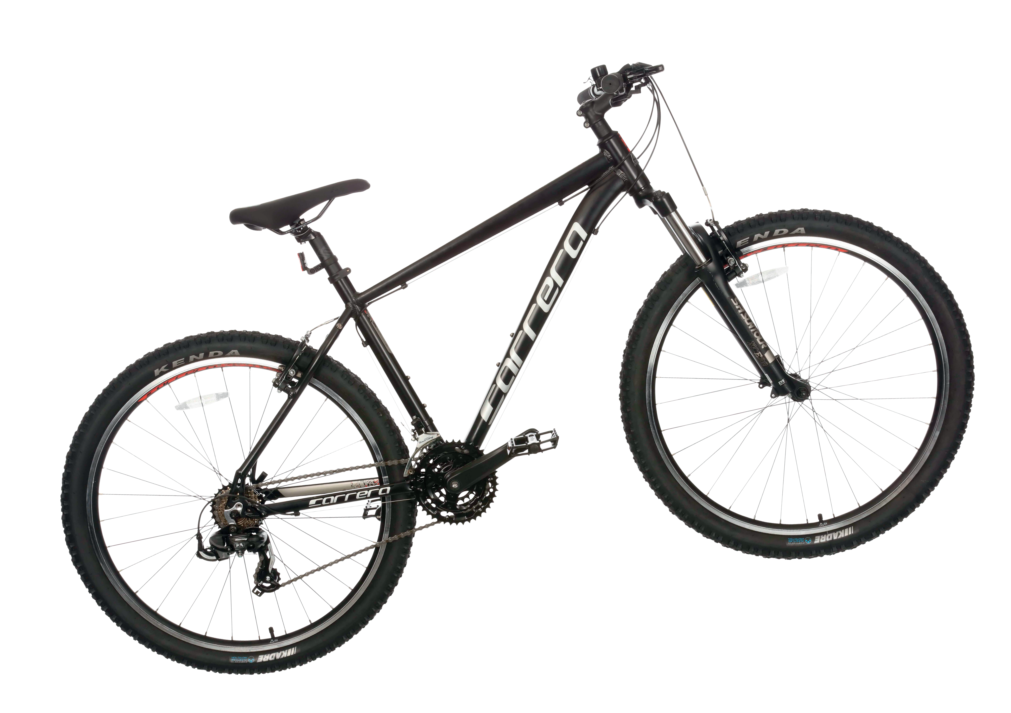
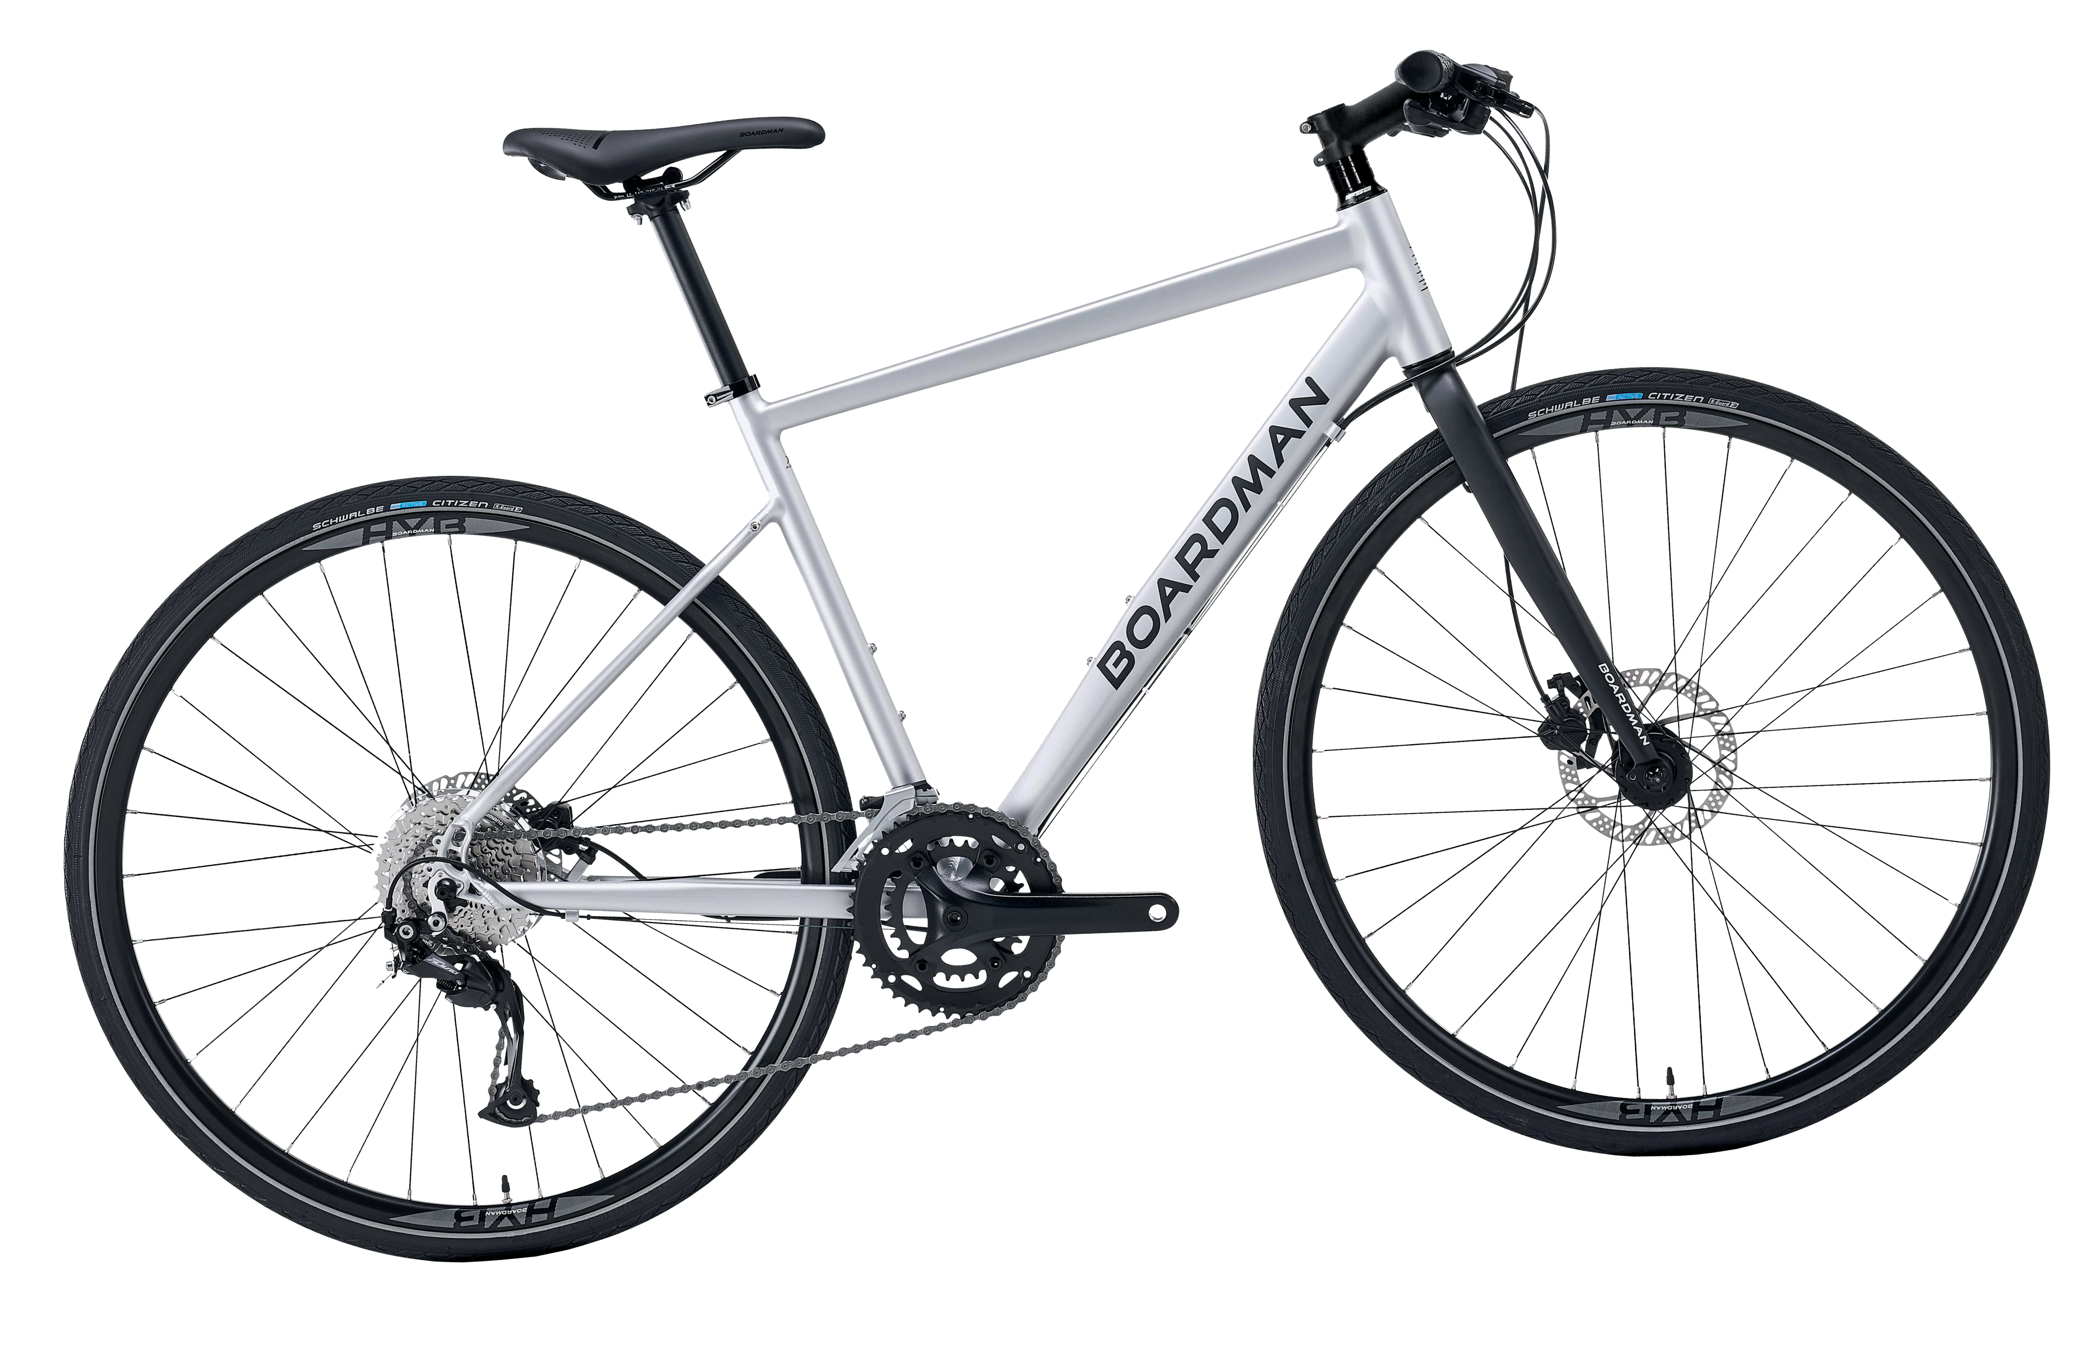


Save up to 47% on a new
bike & accessories
To find out more and for how to apply, SCAN THE QR CODE
OR visit www.halfords.com/cycle2work
USE EMPLOYER CODE: EA12C2W
For E bikes Apply from 25/12/2023 until 10/01/2024
For Pedal bikes Apply from 25/12/2023 until 22/01/2024
STARTS DEC 25TH 2023
PLUS, ACCESS UP TO
30%
OFF
A range of adult mechanical bikes and e-bikes,
*on top of Cycle2Work savings!
*Up to 47% Cycle2Work savings will vary depending on employee tax bracket.
12/10/2023 14:21

