Slide 1
Financial Wellbeing
AVC’s
Sean Bruen – Financial Advisor
Notes:
I’m Sean Bruen and I work for Kith & Kin Financial Wellbeing, I’m a Financial Advisor with nearly 20 years experience , Kith & Kin Financial Wellbeing has been set up to provide Financial Information, knowledge and the Practical tools to help give the confidence to people to change their situation for the benefit to you and your family, people also are provided with free access to Financial Advice. Our aim is based on Prevention, if people have the knowledge around Financial Services it will stop them going to organisations for help after it’s too late, we use an example that if a workforce were all being diagnosed with a serious illness, you would try and treat the disease, but surely you would look into why the lifestyle of the staff to see why they are contracting the illness in the 1st place….

Slide 2
Making the Most of Your Money
We are a Social Enterprise that provides Financial Wellbeing for Employees
All our Profits are Invested for Social Good
Our Staff are all salaried and not paid by Sales or Commission
Employees are not charged for this service or advice
Notes:
We are a Social Enterprise that means all our profits are invested for Social Good in N Ireland, all our staff are salary based and not paid by sales or commission, so that means when we give advice we are not under any pressure to sell products and clients can relax knowing our advice is based on their best interests, and not ours !
We do not charge individuals for this service, so you are probably wondering how do we get paid ? We are funding from 3 sources, we get funded as a Social Enterprise from places such as Public Health Agency, Employers also pay us to provide this service to their employees and when give advice, we receive commission from Banks & insurance Companies just like any other advisor, the difference being we don’t charge for the advice on top !

Slide 3
Access to Financial Advice
Accident / Sickness Redundancy Cover
Estate Planning
Savings
Investments
Wills / Trusts
Income Protection
Mortgage
Budget Planning
Home Insurance
Life Cover
Pensions
Critical Illness
Notes:
We provide access to many areas of advice, from mortgages, insurance, to savings and Pensions, we also cover estate planning and even wills, some of these areas are covered by us and some are covered by our partners, so for example we link up
With a Solicitor in Belfast that can help with Wills & Trusts, for a basic will they charge around £50 with a discount if you come from us, as a Social Enterprise.
3

Slide 4
Money Advice
AVC’s
Additional Voluntary Contributions
AVC schemes were introduced to allow members of workplace pension schemes to build up additional pension benefits. AVC schemes may be offered by employers

Slide 5
AVC’s
If you’re a taxpayer you get valuable tax savings on your regular contributions, as your employer takes them from your pay before its taxed. Tax savings will depend on your individual circumstances and rules can also change.
retire on your planned retirement date, but potentially with more money.
your employer’s pension scheme benefits might not be enough to fund the kind of lifestyle you want in retirement.
https://www.moneysavingexpert.com/savings/discount-pensions/

Slide 6
Current EANI Pension
Before you decide to invest in AVC’s you need to know how much your current company pension is worth ?
Have you maxed into your current company pension ?
When looking at retirement, do you know when you are eligible for the state pension ? So you can calculate this in. if not
You can find out when you will receive your state pension using this link
https://www.gov.uk/state-pension-age

Slide 7
Financial Options
Your EANI Pension and AVC details
https://www.nilgosc.org.uk/additional-voluntary-contribution

Slide 8
Types of pensions
Defined Benefits
(DB)
Defined Contributions
(DC)
Notes:
Link – as I said before, pensions are still traditionally the most common way to save for your retirement, so let’s look at two different types of pensions
I’ll start with a Defined Benefit Scheme, also known as a DB pension.
With a DB pension the amount you get at retirement is based on how many years you’ve worked for your employer and the salary you’ve earned. This type of pension is offered through your employer.
The other type of pension is called a Defined Contributions Scheme, also known as a DC pension.
With a DC pension you build up a pot of money that you can then use when you come to retire. How much money you get depends on several factors including the amount you pay in, any employer contributions (if applicable), tax relief and the investment performance of your chosen fund. The value of your investment can go down as well as up so you might get back less than you put in.
You may have heard of the different types of DC pensions, they include:
Personal Pensions, Group Personal Pensions, Stakeholder Pensions and Self Invested Personal Pensions (SIIPs)
Link – we’ll now look at DB pensions in more detail

Slide 9
Benefits of a DB pension
Guaranteed pension income and lump sum provision
Fixed Benefits
Employer Covenant
Deferred Membership
Transfer options
Notes:
Guaranteed pension income and lump sum – the income is for life and can increase each year by escalation. But the pension amount will be reduced as the scheme will need to pay it out for longer.
Fixed benefits – the benefits available from the scheme are set in the schemes rules i.e death benefits, early or late retirement options and the pension you receive. We’ll look at how this works in a moment.
Employer covenant – This is the employer’s legal obligation and financial ability to support their DB scheme now and in the future.
Deferred membership - If you’ve left employment or no longer eligible to be a member of the DB scheme you’re known as a deferred member. You have the option to leave your benefits within the scheme until retirement (if more than 2 years service). You’ll no longer build up pensionable service but your benefits will be increased in line with the schemes agreed revaluation rate.
Transfer options – If you’re not already taking your pension, you may be able to consider transferring your DB scheme, if it’s in your best interest. However, there’s certain circumstances where this isn’t available, your scheme administrator will be able to confirm your options.
Things to note re DB’s:
Most schemes have a normal retirement age of 60 or 65. You might be able to take your pension earlier but this will potentially decrease the amount of income you get and depends on scheme rules.
If you do transfer from a DB scheme you’re giving up valuable benefits and might find yourself worse off.
LINK: Lets now look at the formula for calculating how much you can get at retirement from your DB scheme.

Slide 10
How much will I get?
Example
Pensionable service
Pensionable earnings
Accrual rate
Years in scheme – 10 years
You retire on a salary of – £24,000
Your scheme accrual rate – 1/60th
10 x £24,000/60 = £4,000 a year
Notes:
Pensionable service – this is the number of years you’ve been a member of the scheme.
Pensionable earnings – this could be your salary at retirement ‘final salary’ or salary averaged during your working life; ‘career average’, or other formula.
Accrual rate – is the proportion of your pensionable earnings you’ll get as a pension for each year in the scheme (e.g., 1/60th or 1/80th). Here we’re using 1/60th - this is just a generic example and not specifically relating to any scheme.
Defined Benefit schemes are protected by the Pension Protection Fund. This pays compensation to the scheme members if the employer becomes insolvent and the scheme doesn’t have enough funds to pay their liabilities. The compensation might not be the full amount and the level of protection depends on whether you’re 1) already drawing benefits, 2) a deferred member who has left the scheme but has built up an entitlement.

Slide 11
Benefits of a DC pension
Help from the Government
Flexibility on the way in
Investment options to suit you
Flexibility on the way out
Notes:
Link – We’ve had a look at DB pensions. Now let’s have a quick look at Defined Contribution pensions and the benefits available under these.
Help from the Government – as I mentioned before the Government will help you save. You can get tax relief on pension contributions, so the money you’d have paid to the Government as tax goes into your pension instead. There’s limits on how much relief you can get. Even if you don’t pay tax you could still get tax relief added to your contributions up to £3,600. Your tax relief could change depending on your circumstances and tax rules can also change in the future.
Flexibility on the way in - You can decide how much you contribute. And you can change your contributions at any time.
Investment options to suit you – There are different options for you to choose from when it comes to investing your pension contributions. It’s important that you regularly review your chosen option. For example, as you get older, you may want to change to less risker funds as you’re closer to retirement.
Flexibility on the way out – When you want to take your money from your pension pot, you have a number of options to choose from.
Link - Lets look at what you need to think about before you do this

Slide 12
Things to think about
How long you’ll
need your money to last
What your living costs might be
How long you want to keep working
How much tax you might pay
How much you want to leave behind
How health and/or lifestyle could affect
what you get
Notes:
So before you make any final decisions about how you want to take your money, here’s a few things to think about:
How long you’ll need your money to last
We mentioned earlier how people are generally living longer. So you’ll need to plan carefully to make sure you have enough to live on for the rest of your life.
What your living costs might be
Remember I showed you before what today’s money would be worth in 25 years time? Well it’s worth remembering that inflation has been low for some years – which means the prices of everyday things like food, petrol and energy haven’t gone up that quickly. But if they go up over time, your money won’t stretch as far as it does now.
How long you want to keep working
If you’re happy to keep working, you could leave your money in your pension pot until you need it. Or you could reduce your hours and dip into your pot to make up the difference.
How much tax you might pay
You can usually get the first 25% of you pot tax-free. But if you take out more, you might need to pay tax depending on your circumstances and the options you choose. And if you’re getting an income from somewhere else this could push you into a higher tax bracket. Tax rules can also change in the future.
How much you want to leave behind
You may want to leave either an income or a lump sum to your loved ones when you die.
How health and/or lifestyle could affect what you get
If you and/or your partner have certain health or lifestyle conditions, this could increase the income you get from one of the options. Also with a terminal illness where live expectancy is less than a year, there may be the option to take the pension pot entirely tax-free.
Link – so now lets look at your options in more details

Slide 13
Flexible ways to take your money
Cash in your pension all at once
Get a guaranteed income for life (an annuity)
Flexible cash or income (drawdown)
Do nothing or take a combination of these options
Notes:
Link - these options are currently available from age 55:
Cash in your pension all at once – you can take your whole pension in one go, as a lump sum. Normally the first 25% is tax-free, but on the remainder, you could pay 20%, 40% or even 45% in income tax, if it pushes you into a higher tax bracket (especially if you’re still earning). Please remember if you are taking cash you will need to give consideration to how you would fund your retirement.
Get a guaranteed income for life (also known as an annuity) – You can use your pension pot to buy an income for life. It pays you an income (a bit like a salary) and is guaranteed for life. These payments may also be subject to income tax. And in most cases you can take 25% of the money you move tax-free. You need to do this at the start and you need to take the rest as an income. When you die, only if you’ve chosen a joint life option or guarantee period, you can pass on the regular payments to a loved one, but you can’t normally leave a lump sum to them. If you or your loved one have, or have had certain health or lifestyle conditions, with this option you could get a higher income payment.
Flexible cash or income (also know as drawdown) – In most cases you can take up to 25% of the money you move tax-free. You’ll need to do this at the start. You can then dip into the rest as and when you like. You can also set up a regular income with this option. Like the others, any money you take after the first 25% may be subject to income tax. To help minimise the tax you pay, you can take the rest of the money whenever you like, for example over a number of different tax years. This spreads it out, and if you do it this way it could help keep you in a lower tax bracket. Any money you don’t take you can invest in whichever fund/s you choose, giving your money the chance to grow. But as with many investments it can go down as well as up so you might not get back the amount you put in. And when you die, anything left over goes to whoever you’ve nominated to receive it.
You could also do nothing and leave your money invested to continue growing or take a combination of these options.
Link – to bring these options to life let’s look at 3 people, who all got the same pension pot but each had different ideas about how to take it

Slide 14
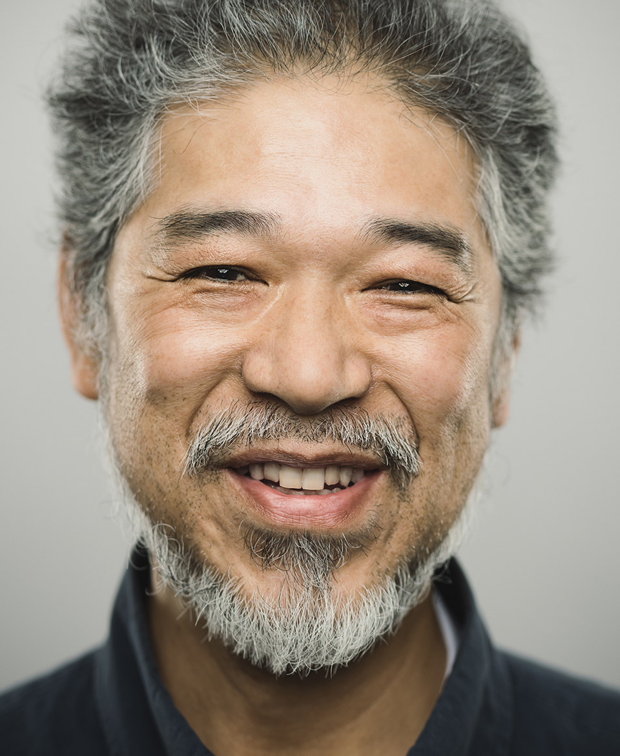
Meet Scott, Simon and Sally
They’ve all got the same amount in their pension pot - £40,000.
They all want to take £10,000 in tax-free cash, right away.
But they each have different ideas about how to do it.
These aren’t real life examples or recommendations.
Notes:
They’ve all got the same amount in their pension pot - £40,000
They all want to take their 25% (£10,000) tax-free in cash, right away
But they each have different ideas about what to do next
These aren’t real life examples or recommendations. You might need to pay tax depending on your circumstances and the options you choose. Tax rules can also change in the future. Also not all these options may be available with your current plan. You may need to transfer to another product or provider.
Link – so lets see how they used their pension pot
pension pot

Slide 15
Scott wants to cash in all his pension pot at once
He has another pension to fund his retirement.
He needs a new car and some urgent repairs on his home.
25% tax-free cash £10,000 to buy a new car
He will pay 40% tax (£12,000) on the remaining £30,000
£18,000 is left after tax – which he can use for the house repairs
After tax, he receives £28,000 from his £40,000 pension pot
This isn’t a real life example or a recommendation.
Notes:
Scott has decided to cash in all his pension at once.
He needs a new car, so will use the £10,000 tax-free cash to pay for that.
He has another pension to fund his retirement, so he wants to spend the remainder straight away on urgent house repairs.
Because he’s taking it all in one go, he has to pay income tax on it. As he is a higher rate tax payer he has to pay £12,000 in tax which means he’ll only received £18,000 from the remaining £30,000.
In total Scott receives £28,000 from his £40,000 pot.
If he was in a lower tax bracket or not earning and didn’t have any other income the £30,000 could still be taxed as income, but at a lower rate.

Slide 16
Simon wants a guaranteed income for life (an annuity)
He wants to spend his 60th birthday in Italy.
But he’s worried about making his pension last his whole life.
25% tax-free cash £10,000 to use towards his Italy trip
He can use the remaining £30,000 to get a guaranteed income for life
He will get £100 a month for the rest of his life
He may pay tax on his monthly payments
This isn’t a real life example or a recommendation.
Notes:
Simon is going to be 60 soon and wants to celebrate his birthday with a holiday to Italy. So he is going to use some of his £10,000 tax-free cash to do that.
He has no children or close family, so isn’t worried about leaving any pension as a lump sum. But he is worried about making his pension last his whole life, as his father lived to the age of 90.
He’s decided to use the remaining £30,000 to buy a guaranteed income for life. Because he’s chosen this option he has to take his tax-free cash at the same time.
We’ve assumed Simon has no health or lifestyle conditions, he’s decided not to leave the money to a loved one, and he wants to receive the same amount every month.
So he’ll receive £100 a month until he dies – even if he lives to 120! But his monthly payments may be taxed as income and when he dies the payments will stop.

Slide 17
Sally wants flexible cash (drawdown)
She wants to give her daughter some money towards her wedding.
But she doesn’t need any more money, for the time being.
25% tax-free cash £10,000 to help with her daughter’s wedding.
She pays £0 in tax and the remaining £30,000 will stay invested, so can go down as
well as up in value.
She can dip into the remaining money as and when she wants.
When she takes the remaining money she might have to pay tax on it.
This isn’t a real life example or a recommendation.
Notes:
Sally’s daughter is getting married and she would like to give her some money towards her wedding. So her £10,000 tax-free cash will come in handy for that.
Because she doesn’t need anymore money than that at the moment, she’s decided to leave the rest invested in a Drawdown account.
This means she can dip into it every now and then, and use it for whatever she needs to. She can decide to take what’s left in regular payments or even use it to buy a guaranteed income for life is she wants.
As her money is still invested it can go down as well as up so she might get back less than £30,000.
And any payments from the £30,000 will be subject to tax. The rate of tax she pays will depend on when and how she takes it, and how much she takes.
On her death, anything money left in her Drawdown account can be passed onto her loved ones. We’ll look at this in more detail in the Giving section.

Slide 18
Recap of their choices
Scott took all his cash at once
Simon got a guaranteed income for life (an annuity)
Sally went for flexible cash (drawdown)
£40,000 pension pot
£10,000 tax-free cash
£12,000 paid in tax
£18,000 cash, after tax
£40,000 pension pot
£10,000 tax-free cash
£100 monthly for the rest of his life – taxable
£40,000 pension pot
£10,000 tax-free cash
£30,000 left invested. How she takes this will depend on if or how much tax she’ll pay.
These aren’t real life examples or recommendations.
Shop around before you decide what to do: pensionwise.gov.uk/shop-around - 0800 280 8880
Notes:
So just to summarise, they all had the same pension pot size, received the same tax free cash amount of £10,000 but:
Scott took all his cash at once and ended up with £18,000 in cash and paid £12,000 in tax
Simon, chose a guaranteed income for life and ended up with £100 each month for life
And Sally, only wanted some of her money upfront, left the rest invested to take as and when she wanted to. The rate of tax she pays will depend on when and how she takes it, and how much she takes.
And remember, you can shop around before you decide what to do.
The retirement options you get from your pension provider might not be the best for you. It’s always worth comparing what you can get from other providers too, because you might be able to get a better deal. The Pension Wise website is a good place to start, pensionwise.gov.uk/shop-around. You can speak to them too, on 0800 280 8880, and book an appointment to meet someone in person.
Link – Just about every option I’ve spoken about has an investment element associated with it. So there’s a requirement to choose where you want your money to be invested.

Slide 19
Contact & Advice
Contact Details :-
Sean Bruen 07732 704808 Email sean.bruen@kithandkinwellbeing.org
Get our Corona Financial Newsletter and Budget Planner
https://www.kithandkinwellbeing.org/coronavirus-advice
Notes:
19

Slide 20
Any Questions?
Notes:
20

