Slide 1
Menopause & Me
Stephanie Reid
menopauseSpring
Notes:
HW

Slide 2
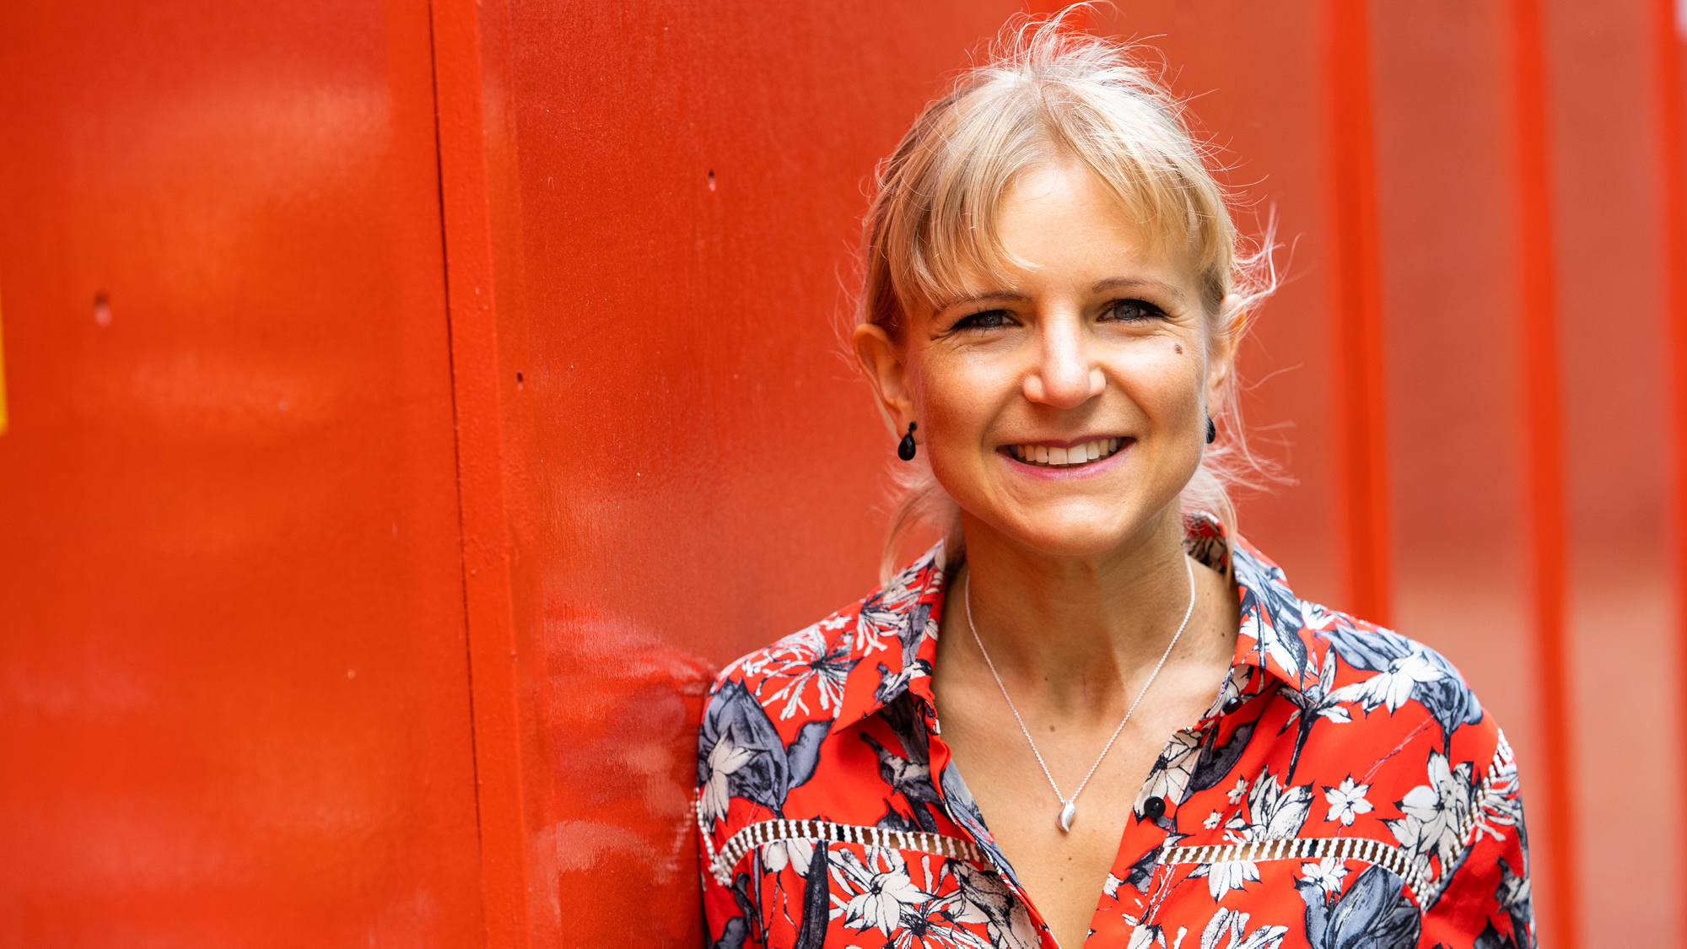
Notes:
GIVE YOUR INTRO add your own picture here.
Delivered corporate training g for over 10 year. Lack of knowledge, when I discovered I was peri menopause. People done talk about it. Women don’t talk aboiyt it so what about men? We have to break this taboo
Touch on your story as reference – as much or little detail as you feel comfortable with is fine.

Slide 3
Poll
When does Menopause start?
How many symptoms are there?

Slide 4
Intro & agenda
What is the menopause?
Treatment options
Prepping for Doctor’s visit.
Top tips

Slide 5
What’s happening to me?
Menopause is a point in time 12 months after a woman's last period. The years leading up to that point, when women may have changes in their monthly cycles, hot flashes, or other symptoms, are called the menopausal transition, or perimenopause. The menopausal transition most often begins between ages 45 and 55.
The impact is physical, psychological and emotional.
All of us will experience it, some more than others.
IT DOES NOT HAVE TO BE AWFUL!

Slide 6
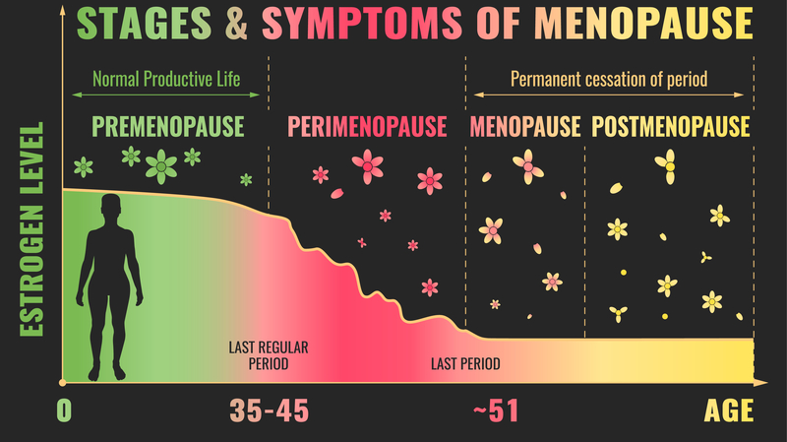

Slide 7
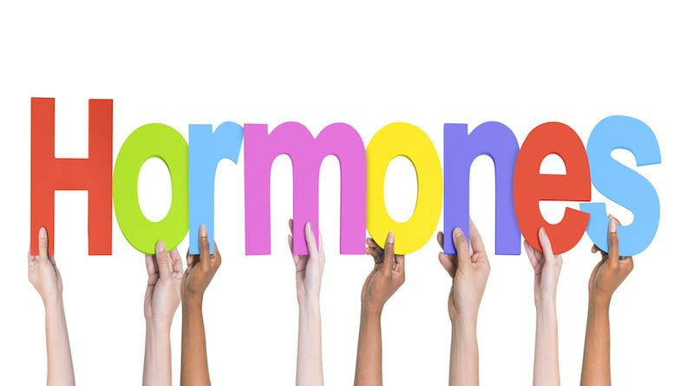

Slide 8
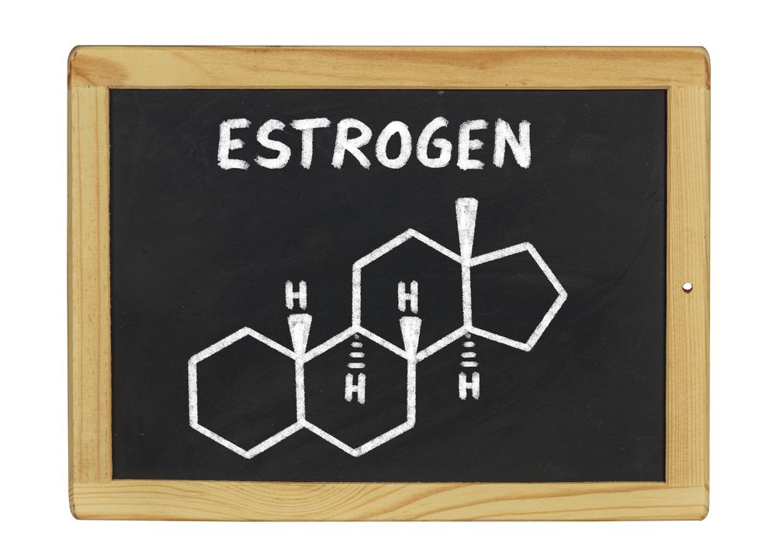
what does it do?
Brain: increases serotonin & serotonin receptors; increases production & effects of endorphins; maintains body temperature.
Heart: increases HDL cholesterol (the good one!); decreases LDL cholesterol (the bad one!); relaxes and dilates blood vessels so blood flow increases; soaks up free radicals in the blood that can damage arteries.
Bladder: strengthens bladder, preventing uterine incontinence; provides protection against UTI’s.
Liver: helps protect against fatty liver disease; regulates production of cholesterol.
Bones: protects against bone loss
Skin: increases collagen; maintains skin moisture; skin elasticity; helps wounds heal faster.
Stomach: prevents inflammation; reduces abdominal fat.
Notes:
Our hormones paly a very important part in our health, and we need to understand what they do because this is important for our long term health.

Slide 9
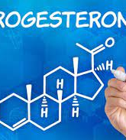
Progesterone: what does it do?
Brain: boosts metabolism; enhances cognitive control; helps you fall asleep & stay asleep; eases anxiety.
Heart: prevents high blood pressure; dilates blood vessels.
Bladder: increases chance of UTI (especially if estrogen is low).
Bones: helps build bones
Skin: smooths skin; promotes hair growth.

Slide 10
Type of Estrogen
Estradiol (E2)- this is the main version of estrogen that is active from puberty to Menopause.
Estrone (E1) – this is the secondary type of estrogen that we produce during our reproductive cycle. We still produce this during and after menopause.
Notes:
We produce Estrone if we still have ovaries and adrenal glands.

Slide 11
Poll on top 3 symptoms
Notes:
This is opportunity for participation
Use a flipchart to record symptoms
Use post-its and get them to write down symptoms

Slide 12
Notes:
Go through and pick out certain symptoms and talk about them and if you feel comfortable talk about your experiences of having a Hot flush, etc

Slide 13
Menopause the facts
Starts in mid forties (but it can happen early due to illness/early onset Menopasue)
Can last for up 10 years
Every woman will go through this
25% will have severe symptoms
Impacts our long-term health
Notes:
It can start earlier due to medical reasons, illness 1 in 100 below age of 40 1 in 1000 below age of 30.
So menopause is not confined to 40s/50s and those going through an early menopause can impact women quite severely as it may to be related to a medical condition so is more complex.

Slide 14
Menopause Facts
72.3% of menopausal women are in work (ONS Stats 2021)
1 in 3 women in work are in the menopause
Sometimes menopause can be misdiagnosed as Mental Health condition.
80% will have symptoms some will be severe and debilitating.

Slide 15
Menopause & Diversity
We are not all the same. Ethnicity, disability, socio-economic background can all have an impact on Menopause.
Neurodiverse & Menopause
Women of colour & Menopause
Notes:
Studies about ND and Hormones – times for women to be diagnosed: puberty, pregnancy, infertility treatment and menopause!!
The fluctuating of hormones especially impacts MH
Women from more deprived areas do not have the same access to services & support
Black women can have a more intense & longer menopause than European women

Slide 16
What can I do to manage my symptoms?
HRT – Hormone Replacement therapy
Diet & Lifestyle Changes
Exercise
Supplements & Vitamins
Herbal
Mindset

Slide 17
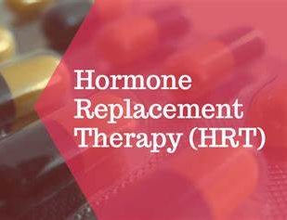
HRT and other medical responses
HRT – Hormone Replacement Therapy
HRT is a treatment that relieves the symptoms of your menopause by replacing the estrogen your body stops producing during your menopause. All forms of HRT contain Estrogen, which will work to ease symptoms such as Hot Flushes, mood changes and urinary symptoms.
Modern HRT is made from natural substances.
Notes:
HRT is free on prescription in Scotland, Wales and NI. New legislation is coming to England re prescription charges, also a lot more health Insurance are now providing Menopasue help/access to Drs and treatment..
HRT replaces the hormones you are losing these are estrogen, progestogen and testosterone.
You will be accessed and proscribe what suits you, your medical history, what medications you are on and where you are in your menopause journey
How does it work? It replaces the hormones that we are losing but it is also more complicated as well.
Some older types of HRT are made from pregnant mares urine but this also contains some hormones we don’t need or want mostly tablet form
Body identical hormones this has the same molecular structure as estorgen in our bodies, it is extractrated from yam and is available as gels, creams, implants, sprays you can also get body identical progestogen also derived from yam. Modern HRT is considered safe
HRT is not suitable for all either Hormone Intolerance or certain cancers
The method of delivery is also important taking HRT in tablet form means that it has to pass through the liver and this can cause blood clots etc
The sprays, gels, creams, implants and patches go directly into the blood stream and with creams, gels and sprays you can control the dosage. You can also use the gels and creams topically especially for vaginal dryness and it only impacts that area.
Some women can also be proscribed testosterone to help with energy and sex drive this can only be proscribed by a Menopasue Doctor
Note on bioidentical hormones these are similar to body identical in that they are made from plant compounds – this type of treatment is expensive and not regulated or tested by NICE

Slide 18
HRT – pros & cons
New HRT is highly effective at relieving symptoms
Risks of HRT – Breast Cancer 1 in 8 will get it. Strokes (oral) Blood Clots (oral)
Evidence suggests it can reduce risks of Cardiovascular Disease
Risk of Osteoporosis reduced
Risk of Type 2 Diabetes reduced.
Bleeding
Hormonal intolerance
Notes:
Side effects of HRT:
Irregular bleeding, leg cramps, breast pains, weight gain could be related to dosage or brand
HRT and contraception HRT is not a contraceptive – you need to talk to a menopasue specialist
Breast cancer new studies have shown that the risk is reduced – that is why you need to provide a full medical history at appointments

Slide 19
Going to the doctor
Be prepared, research your options.
Complete the checklist of symptoms
Ask for a referral to Menopause Clinic/specialist.
Or if you can use your EAP/Health Insurance and see a specialist (tests, prognosis and treatment plans)
You are not going to get this right on the first try, be prepared to try a few options.
This is your body, you know it best, listen to it.
Notes:
Mention bringing a symptom tracker or using an app such as: Balance App

Slide 20
Doctor’s appointment
List of medications
Medical history
Key changes – period flow, frequency, sleep quality and duration.
Bring Symptom Tracker with you.

Slide 21
What is the alternative?
Supplements and vitamins
Herbal remedies
CBT – Cognitive Behavior Therapy
DIET & EXERCISE!!!

Slide 22
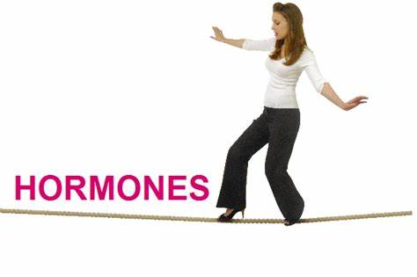
Balancing Hormones
Stress
Environment
Diet
Lifestyle
Notes:
Contamination from chemicals can impact our hormone system. Chemicals found in plastics, in some cleaning products etc.
Stress is a major disruptor of our hormones
Lifestyle factors such a s smoking, vaping, or drinking can increase symptoms
Such things as Aspartame (due to be banned by WHO) which is a carcinogentic have a dramatic impact on our hormone system.

Slide 23
Herbal Remedies
Black cohosh - Is a SERM (selective oestrogen receptor modulator) – stimulate oestrogen receptors in some part of body e.g. bones and brain. It does not stimulate in womb or breast (don’t wish to have overstimulation which may increase risk of cancer).
Agnus Castus – balances hormones particularly effective in perimenopausal stage.
White Sage – helps reduce Hot flushes and Night Sweats (tablets, drops or tea)
Milk Thistle – balances hormones and helps detoxify liver.
Ginkgo – helps with memory and concentration. (Take in morning)
Red clover: for Night Sweats, Hot flushes, bone density, heart and Blood pressure.
Notes:
Big developments in this area with introduction of Phytoestrogens derived medicine this will be isolating and producing Lignans & flavniods also Red Clover Holland & Barrett have trained up staff in Menopause!!

Slide 24
Supplements
B Vitamin Complex – excellent for anxiety, nervous system, mood, good for heart & immune system and gives you energy!!!
Vitamin C – helps reduce Hot Flushes; helps produce collagen for dry skin & vaginal dryness
Vitamin E as above also helps with Heart Health.
Vitamin D – bone health; heart health; immunity; Mental Health
Omega 3 Fatty Acids – mood and brain health; anti-inflammatory; dry hair & skin; aching joints etc
Magnesium – bone health; anxiety; sleeping and irritability
Calcium – bone, teeth & hair; heart health; muscles
Notes:
Vitamin D helps calcium be absorbed take extra October to March and Maca powder is an adaptogenic that means it helps adjust the bodys response to what is needed. From studies it seems to help the body produce its own estrogen and progesterone

Slide 25
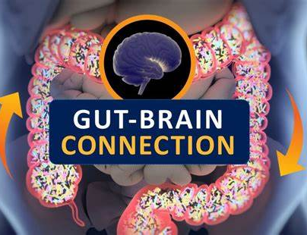
Gut – Brain Connection
Prebiotics
Probiotics
A Healthy gut leads to a Happy brain.
Notes:
We need a healthy gut for our immune system and mental health, we can create serotonin in our stomachs!
By having a well balanced diet and increasing foods such as: garlic, onions, green vegs, apples and foods with live bacteria

Slide 26
What happens in the Gut?
Notes:
How to get a healthy gut?
Prebiotics – foods rich in fibre that feed the gut bacteria
Probiotics – foods that contain live bacteria such as yogurt, kefir, kombucha and other fermented foods.

Slide 27
Phytoestrogens
Notes:
HW – Remember the estrogen that we were talking about earlier? Well – these foods are plant based compounds that mimic in our bodies so get as much of these into your diet as you possibly can.
Increasing these foods and eliminating as much processed foods will help with menopause symptoms and are also good for long term health.
Hummos - Chickpeas – garlic, tahini (seasma)

Slide 28
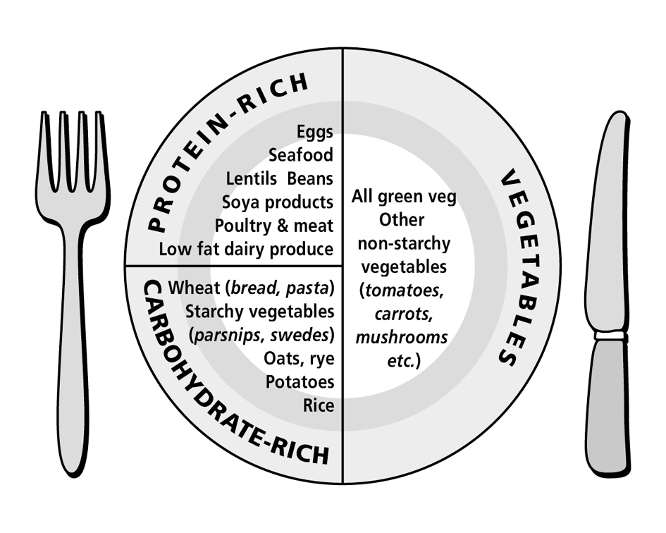
The Balanced Plate
Don’t worry about counting non-starchy veg – have these fill half your plate at lunch and dinner
Choose lean protein. You can have decent quantities of these – about ¼ plate. Again, don’t measure
0 GL
3 GL
Fats: reduce saturated fats and increase essential fats. Oily fish twice a week and a handful of seeds every day
peppers
7 GL
Just focus on getting the right type and amount of starchy carbs – see guides for how much makes 7GL
Fruit: 2 pieces of low GL fruit a day with a couple of tablespoons of nuts / seeds

Slide 29
Managing Stress
Know your stress triggers
Breathe
Meditation – Mindfulness
Yoga
Connection
Getting outside – swimming
Therapy
Be kind to yourself and others
Notes:
Stress is a big factor it does not mix with our hormones and we all suffer from some form of chronic stress.
We need to manage this as it impacts our physical and mental health.
Breathe
Meditation – mindfulness/yoga etc

Slide 30
Exercise
Yoga
Pilates
Walking
Strength bearing exercises
Notes:
We need to build our bone density and build our core strength for balance (falls, tripping) we also need more flexibility

Slide 31
Sleep ….
We need to prioritize sleep during the menopause
Your bedroom is for sleep
Don’t have any electronic devices in the room (out them on airplane mode)
Go to bed and wake at the same time, build a routine
Magnesium an hour before bed (tablet, spray or bath)
Keep the room cool (get Doggy Cool Sheets and place under bedsheets – a cool spot!)
Notes:
Sleep can become a big issue and can make symptoms worse, so it is really important to sort it out

Slide 32
Menopause and work
Stress Management
Flexible working
Environment – windows, fans
Time out
Plan your day – morning best for big tasks
WRITE IT DOWN !!!
Take a break from screens – Stand up Desk
Support group in work, online in the community.
Notes:
1 in 3 women in workplace are going through the menopause. Ask do they have policy? There are new BS standards for Menopause
BS_30416 (1).pdf

Slide 33
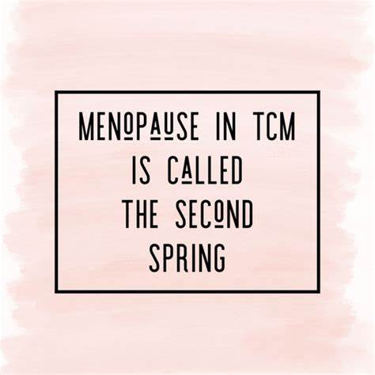
Remember…..
As your hormones decrease your ability to say no increases and that is a very good thing!!

Slide 35
Thank you www.menopausespring.com

